Slide 1
POC Procedures Working Group (POC-pWG)
11 March 2016

Slide 2
Agenda slide
Background
Pre-Consultation Paper
Procedure Updates
  Work Packages 1, 2 and 3
  Consultation Process Overview
  Program Overview – Work Package 2
AEMC update on MRP rule change

Slide 3
1. background
AEMO has facilitated three POC-PWG workshops since February 2016
  The workshops have discussed specific topics relating to matters from the following AEMC rule determinations:
    Competition in metering and related services
    Embedded networks
    Meter replacement process
The aim of the workshops has not been to litigate the rules, but rather to focus on topics where AEMO has needed further input and information from stakeholders to update the Procedures

Slide 4
1. background
Attendance at the workshops has been excellent, comprised mainly of technical SMEs from a broad range of industry stakeholders
AEMO has circulated meeting notes from each workshop that capture industry stakeholder views to topics that were discussed at the workshops, including specific questions posed to workshop attendees.
Workshop #1 (3-4 Feb) Identification of type 4 metering Validation and substitution for type 4 Sample metering Network device management requirements Emergency priority requirements Meter churn | Workshop #2 (15-16 Feb) MSATS requirements Change Request Codes Objection code review B2B requirements RoLR requirements Network Tariff Code Updates | Workshop #3 (2 Mar) Minimum Services Specification Embedded Networks Metrology Requirements – Revisited Metrology Part A – Jurisdictional Matters

Slide 5
1. background
Another workshop is planned on 17 March to discuss draft B2B Procedure changes
A large quantity of information has been collected by AEMO at these workshops - AEMO is currently assessing this information as part of its update to the Procedures
At this stage there are no further topics where AEMO needs further input and information from industry stakeholders to update the Procedures
The next POC-PWG meeting is scheduled for 14-15 April (as per the placeholder in the 2016 Industry Meeting Schedule)

Slide 6
2. PRE-CONSULTATION Paper
At the workshop on 2 March, AEMO indicated that would develop a Pre-Consultation Paper outlining its position on each of the topics discussed at the workshops (excluding B2B Procedures)
The positions conveyed in this paper will be the same position that AEMO will take to formal consultation commencing on 22 April
The paper will be released by 8 April, along with the new glossary and at least one sample procedure

Slide 7
3. Procedure updates
The changes to the NER require that AEMO and the IEC create or amend existing procedures
There are approximately 45 documents that need to created or amended, spread over three Work Packages
Work Package 1 – to be published by 1 September 2016
  Metrology Procedures, Service Level Procedures, MSATS Procedures, B2B Procedures and Formatting Procedures
Work Package 2 – to be published by 1 March 2017
  Accreditation and Deregistration Procedures, guidelines, etc.
Work Package 3 – to be published by 1 December 2017

Slide 8
Work package 1
Ref | Document | New or Existing
1 | Meter Churn Procedure | Existing
2 | Network Device Procedure | New
3 | Service Level Procedures for MDP | Existing
4 | Service Level Procedures for MP | Existing
5 | Metrology Procedure: Part A | Existing
6 | Metrology Procedure: Part B | Existing
7 | Minimum Services Specification | New
8 | Meter Data File Format | Existing
9 | Emergency Priority Procedures | New
10 | Glossary and Framework | New
11 | MSATS Procedures: MDM Procedures | Existing
12 | MSATS Procedures: CATS Procedure Principles and Obligations | Existing
13 | MSATS Procedures: Procedure for the Management of Wholesale, Interconnector, Generator and Sample (WIGS) NMIs | Existing
14 | NEM RoLR Process Part A - MSATS Procedure: RoLR Procedures | Existing
15 | B2B Procedure Customer and site Details Notification Process | Existing
16 | B2B Procedure Service Order Process | Existing
17 | B2B Procedure Technical Delivery Specification | Existing
18 | B2B Procedure Technical Guidelines | Existing
19 | B2B Procedure Meter Data Process | Existing
20 | B2B Procedure One Way Notification Process | Existing

Slide 9
Work package 2
Ref | Document | New or Existing
21 | MSATS Introduction Guide | Existing
22 | MSATS User Interface Guide | Existing
23 | Operating Procedures MSATS CATS History Model | Existing
24 | Operating Procedures MSATS NMI Discovery Questions and Answers | Existing
25 | Operating Procedures MSATS-CATS Hints and Tips | Existing
26 | Metering Service Provider Accreditation Checklist | Existing
27 | Metering Service Provider Accreditation Procedure | Existing
28 | Metering Service Provider Application Form (Part 2) | Existing
29 | Metering Service Registration Procedure (Part 1) | Existing
30 | Service Provider Compliance & Assessment and Deregistration Procedure | Existing
31 | MC Application Form | New
32 | Service Level Procedure for ENM | New
33 | ENM Accreditation Checklist | New
34 | ENM Accreditation/deregistration procedure | New
35 | ENM Application Form (Part 2) | New
36 | ENM Registration Procedure (Part 1) | New
37 | Metering Coordinator Registration Procedure (new) | New
38 | Metering coordinator default procedure (standalone?) | New

Slide 10
Work package 3
Ref | Document | New or Existing
39 | List of accredited ENMs in the NEM | New
40 | Exemption Procedure - Type 4A | New
41 | List of National Electricity Market Procedures, Guidelines, and Documents required by Chapter 7 | Existing
42 | Exemption Procedure - malfunctioning metering installations | Existing
43 | National Metering Identifier Procedure | Existing
44 | National Metering Identifier Allocation List | Existing
45 | Role of the Responsible Person (MC) - explanatory info | Existing

Slide 11
Consultation process overview

Slide 12
Consultation dates
Deliverable / Milestone | Project | Description | Planned date
AEMC publish final rule determination | MRP |  | 10 Mar 16
AEMO pre-consultation workshops conclude | MC,EN,MRP |  | 17 Mar 16
AEMO releases Pre-Consultation Paper | MC,EN,MRP |  | 08 Apr 16
AEMO publishes notice of first stage consultation (B2B) | B2B: MC,EN,MRP |  | 08 Apr 16
Industry Workshop Placeholder | TBC |  | 14/15 Apr 16
AEMO publishes notice of first stage consultation | MC,EN,MRP |  | 22 Apr 16
Industry Workshop Placeholder | TBC |  | 16/17 May 16
AEMO concludes first stage consultation (B2B) | B2B: MC,EN,MRP |  | 17 May 16
AEMO concludes first stage consultation | MC,EN,MRP |  | 31 May 16
AEMO publish draft procedure determination (B2B) | B2B: MC,EN,MRP |  | 16 Jun16
Industry Workshop Placeholder | TBC |  | 20/21 Jun 16
AEMO publish draft procedure determination | MC,EN,MRP |  | 30 Jun 16
AEMO concludes second stage consultation (B2B) | B2B: MC,EN,MRP |  | 1 Jul 16
Industry Workshop Placeholder | TBC |  | 7/8 Jul 16
AEMO concludes second stage consultation | MC,EN,MRP |  | 15 Jul 16
AEMO seeks IEC recommendation for B2B changes | (B2B) MC,EN.MRP | No later than 1 Aug 2016 | 25 Jul 16
AEMO publishes final procedure determination | B2B) MC,EN,MRP |  | 12 Aug 16
AEMO publishes final procedure determination | MC,EN,MRP | No later than 1 September | 26 Aug 16

Slide 13
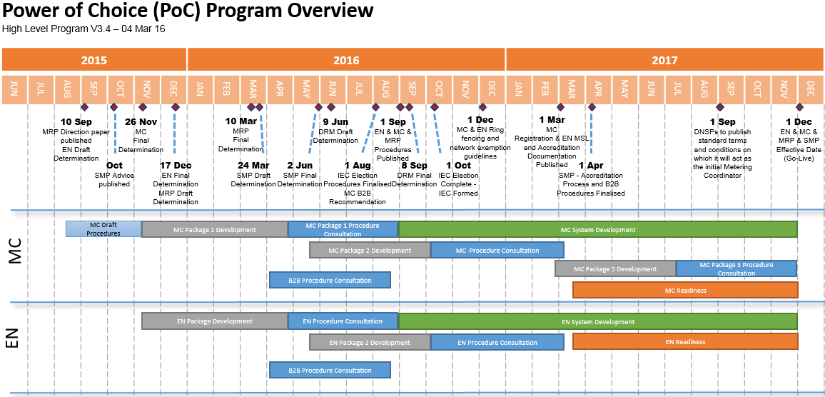
Program overview – WP 2
Work package 2 pre-consultation to begin during the first consultation.

Slide 14
Consultation two dates*
Deliverable / Milestone | Project | Description | Planned date
Industry Workshop Placeholder | TBC |  | 16/17 May 16
Industry Workshop Placeholder | TBC |  | 20/21 Jun 16
Industry Workshop Placeholder | TBC |  | 07/08 Jul 16
Industry Workshop Placeholder | TBC |  | 20/21 July 16
Industry Workshop Placeholder | TBC |  | 22/23 Aug 16
Industry Workshop Placeholder | TBC |  | 08/09 Sep 16
AEMO publishes notice of first stage consultation | MC,EN |  | 10 Oct 16
Industry Workshop Placeholder | TBC |  | 24/25 Oct 16
Industry Workshop Placeholder | TBC |  | 14/15 Nov 16
AEMO concludes first stage consultation | MC,EN |  | 15 Nov 16
Industry Workshop Placeholder | TBC |  | 28/19 Nov 16
Industry Workshop Placeholder | TBC |  | 13/14 Dec 16
AEMO publish draft procedure determination | MC,EN |  | 14 Dec 16
AEMO concludes second stage consultation | MC,EN |  | 03 Jan 17
AEMO publishes final procedure determination | MC,EN | No later than 1 March 2017 | 15 Feb 17
Tentative dates for consultation two.
PoC workshop placeholder dates could be utilised for other work streams or projects - SMP | IEC as required.

Slide 15
close
Questions?
Contact: poc@aemo.com.au

