Slide 1
Virtual Power Plants Demonstrations
Information webinar
17 December 2018
Matt Armitage – Principal, DER Program

Slide 2
Demand response
Load shifting
Distributed Energy Resources
Distributed
Energy
Resources
Distributed generation
Distributed storage
Definition:
Distribution level
resources which
produce electricity or
actively manage
consumer demand
Virtual Power Plants
VPPs in current Australian context = using software to remotely coordinate fleets of batteries and rooftop PV located behind the meter, but may also include DR

Slide 3
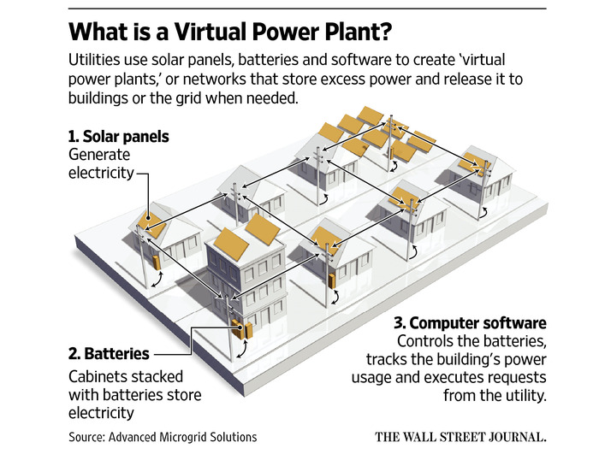

Why – VPPs are already here and growing: possibly up to 700 MW by 2022
VPP project | State | Systems / $ | Total capacity (Est. MW) | Timing
Reposit “Grid Credits/Impact” with Powershop/Diamond energy | ACT,VIC, NSW, SA, QLD | Confidential | n/a | Current
AGL VPP | SA | 1000 | 5 | By early 2019
Simply Energy (Incl. Tesla, Greensync) | SA | 1200 | 5.2 | By early 2019
Tesla (SA housing trust) | SA | 1000 to 50,000 | 5, up to 250 | Total by 2022
SA Govt Storage Subsidy Scheme | SA | 40,000, $100m | 200 | By 2022
NSW Govt subsidy scheme (TBC) | NSW | 40,000, $40m | 200 | By 2023
VIC Govt subsidy scheme | VIC | 10,000 $25m | 50 | By 2022
Next Gen Energy Storage Program | ACT | Up to 5,000 | 36 | By 2021
Origin VPP | VIC | 650 | 5 | 2019-2020
Yurika VPP | QLD | Confidential | n/a | Current
Bruny Island | TAS | 40 | 0.2 | Current

Slide 4
Why: VPP context
VPPs being installed across Australia, largely driven by subsidy schemes incentivising thousands of units
VPPs want to explore commercial feasibility of the ‘value stack’ delivering energy and FCAS from BTM
Projects are planning for small scale deployment initially (~1MW) 2018-19, then scaling up in 2019-20
BUT…
Current regulatory framework does not allow full ‘value stack’ (energy & FCAS)
VPP operations are currently ‘invisible’ to AEMO and VPP growth may present system security risks if appropriate visibility is not implemented
VPP cloud-to-cloud communication and control technology is at cutting edge globally
  Teething issues expected in development – must be resolved to be considered ‘proven and reliable’
  AEMO keen to observe VPP service reliability under variable voltage conditions
AEMO’s FCAS high speed metering requirements are non-commercial for many BTM applications – a more innovative measurement & verification solution is required to facilitate FCAS delivery from DER
VPP Demonstrations to facilitate operational visibility while VPPs are developing
Enables practical learning on how to integrate VPPs into market frameworks and operational systems

Slide 5
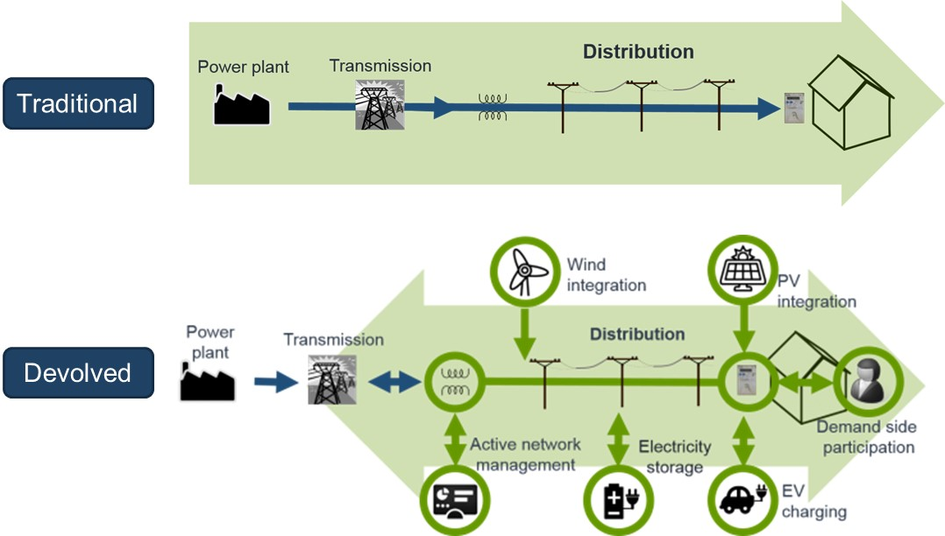
Why: building momentum for DER integration
Finkel:
“The future grid will be more distributed, but its security and affordability will be strengthened through smarter grids…and new ways of trading”
“AEMC to recommend a mechanism to facilitate demand response in the wholesale energy market”
Vision of the future power system
AEMC RFR:
“DR aggregators (DRAs) should be recognised on equal footing with generators in the wholesale market”
“Recommends changes to enable consumers to access multiple service providers at a single connection point”
Active
Passive
ACCC:
“A mechanism should be developed for third parties to offer demand response directly into the wholesale market. The mechanism should:
Allow widest range of businesses to offer DR, promoting competition
Not allow retailers to limit ability of customers to engage DRAs
Ensure load and generation responses are valued based on the benefit they provide to the wholesale market
Limit technical requirements that could inhibit uptake, e.g. multiple meters at the customer site.”
Joint ARENA-AEMO
DR RERT Trial
RERT
All resources optimised in real time within technical limits
Wholesale Demand Response rule change proposals
Distributed Energy Integration Program (DEIP) and AEMO DER Program

Slide 6
AEMO DER Program
Integrating DER to maximise consumer value
DER
Workstream
Pilots
Customer
Data
Market
Standards
Operations
Communication
& Education
Workstream
objectives
Use pilots to inform change – partner with key stakeholders to inform operational and market design requirements
Visibility of DER for
operational, forecasting,
planning, and market
(incl settlement) functions.
Consumer and third party access to data and services to enable better service offerings/choice for consumers
Integrate DER into energy,
ancillary and reserve markets.
Market arrangements recognise new models, including third-party/aggregator concepts.
Evolve market arrangements to a distributed market model.
Network regulation & pricing facilitate DER and better customer service offerings.
Where appropriate,
a nationally consistent
approach to DER
connections and
develop DER
technical standards.
To better understand
operational challenges and DER capabilities to inform operational
processes and tools.
Better operational tools to operate in high DER world
Industry-wide collaboration (domestic and international) to deliver outcomes for consumers
Enablers
Broader market evolution
Digitalisation (including cyber security)

Slide 7










Distributed Energy Integration Program (DEIP)
DEIP purpose: Collaborate to maximise the value of customers’ Distributed Energy Resources to the Australian energy system for the benefit of all energy users.
Notes:
How do we use the DEIP to design and execute trials, and obtain appropriate funding

Slide 8
VPP Demonstrations objectives
Primary objective = allow VPPs to deliver energy & FCAS, obtain operational visibility, use learnings to inform changes to regulatory and operational frameworks
Allow participants to demonstrate basic control and orchestration capability for VPPs providing energy and FCAS
Develop systems to deliver operational visibility of VPPs to new AEMO API
  To understand impact on power system security and interactions with the market.
Assess current regulatory arrangements affecting participation of VPPs
  Inform new or amended arrangements where appropriate
  Assess AEMO’s draft DER Contingency FCAS Specification

Slide 9
Three models for VPP Demonstrations participation
Retailer engages with VPP operator
Retailer is also the VPP operator
VPP operator as MASP
Services: Energy and FCAS
Services: Energy and FCAS
Services: FCAS only
AEMO
AEMO
AEMO
Meter data (via MDP)
Submit operational data
Meter data (via MDP)
Submit operational data
Submit operational data
Retailer
(FRMP)
VPP operator
Retailer
(FRMP and VPP operator)
VPP operator as MASP (allow generation as negative load)
Commercial agreement
FRMP =
Financially Responsible Market Participant
MASP =
Market Ancillary Services Provider

Slide 10
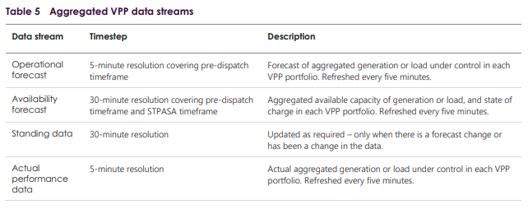
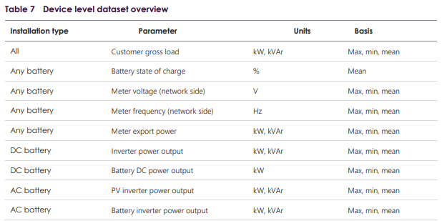
Data requirements
Aggregated VPP data set
For Operational Forecasting group
To inform what ‘near real time’ data is required in future to manage supply-demand balance
Device level data set
Multiple purposes
To inform:
  Long term forecasting models
  Load models
  Assessment of current NER/operational procedures
Not necessarily indicative of on-going data requirements
Need to find balance between cost-benefits for VPP Demonstrations
Data transfer via new API – separate consultation
Linkages with other API projects

Slide 11
Next steps
Consultation closes on 21 December
  Send to DERProgram@aemo.com.au
  Intend to publish submissions – identify anything to be kept confidential
Q1 2019
  Digest feedback to develop Terms of Reference for participation
  Use focus group to develop and refine API specification
  Build systems to facilitate VPP Demonstrations
Q2 2019
  Begin enrolment process and start the demonstrations

